Slide 1
TEMPOROMANDIBULAR JOINT (TMJ)
DR. F.O OPOOLA

Slide 2
INTRODUCTION
The temporomandibular joint (TMJ) is a hinge type synovial joint that connects the mandible to the rest of the skull.
More specifically, it is an articulation between the mandibular fossa and articular tubercle of the temporal bone, and the condylar process of the mandible.
Even though the TMJ is classified as a synovial-type joint, it is atypical in that its articular surfaces are lined by fibrocartilage rather than hyaline cartilage.

Slide 3
Temporomandibular joint (TMJ)
STRUCTURE; The main components are the joint capsule, articular disc, mandibular condyles, articular surface of the temporal bone, temporomandibular ligament, stylomandibular ligament, sphenomandibular ligament, and lateral pterygoid muscle.
FUNCTION;The main function of the temporomandibular joint is to facilitate movements of the lower jaw. This joint allows a range of movements of the lower jaw, namely translational movements (protrusion/retraction and lateral deviation) and rotational movements (elevation/depression)

Slide 4
Articular surfaces | Temporal bone: Mandibular fossa and articular tubercle Mandible: Condylar process
Main components | Joint capsule Synovial membrane Articular disc (anterior/posterior bands, intermediate zone)
Ligaments | Major: Lateral temporomandibular ligament (thickened lateral portion of capsule, strengthens TMJ laterally) Minor: Stylomandibular ligament, sphenomandibular ligament
Cavities | Superior (discotemporal) cavity (translational movement) Inferior (discomandibular) cavity (rotational movement)
Rotational movements | Elevation: Temporalis, masseter and medial pterygoid muscles Depression: Lateral pterygoid, digastric, geniohyoid and mylohyoid muscles
Translational movements | Protrusion: Lateral pterygoid, medial pterygoid muscle, masseter Retraction: Posterior fibers of temporalis, deep part of masseter Lateral deviation (left or right): Posterior fibers of temporalis, digastric, mylohyoid and geniohyoid muscles (ipsilateral movement); lateral and medial pterygoid muscles (contralateral movement)

Slide 5
Articular surfaces
The two main bones involved in the formation of the temporomandibular joint are the mandible and the temporal bone.
The temporal bone forms the superior part of the joint with two components: mandibular fossa and articular tubercle.
The inferior part of the joint is formed mainly by the head of the mandible. The head of the mandible, also known as the mandibular condyle, is the posterior end of the ramus of the mandible.

Slide 6
Articular surfaces cont’d
Between these two articular surfaces, there is an interposed structure composed entirely of fibrocartilage, known as the articular disc of the temporomandibular joint.
This disc attaches to the internal aspects of the fibrous capsule and completely separates the articular surfaces of the TMJ.
The disc stabilizes the condyle of the mandible within the joint, reduces frictional forces between the articular surfaces and may aid in lubrication of the joint.

Slide 7
Compartments (cavities)
The articular disc divides the joint into two anatomically and functionally separate compartments: the superior compartment and the inferior compartment. Each compartment is lined by its own corresponding synovial membrane.
The superior compartment is bordered superiorly by themandibular fossa of the temporal bone and inferiorly by the articular disc itself. It is lined by the superior synovial membrane. It contains 1.2 mL of synovial fluid and is responsible for the translational movement of the joint.

Slide 8
Compartments (cavities) Cont’d
The inferior compartment is bounded superiorly by the articular disc and inferiorly by the condyle of the mandible. It is lined by the inferior synovial membrane. It is slightly smaller with an average synovial fluid volume of 0.9 mL and allows rotational movements of the joint.

Slide 9
Ligaments and joint capsule
The joint capsule originates from the borders of the mandibular fossa, encloses the articular tubercle of temporal bone and inserts at the neck of mandible above the pterygoid fovea, which is a depression on the anterior surface of the neck.
The joint capsule is so loose that the mandible can naturally dislocate anteriorly without damaging any fibers of the capsule.
The ligaments involved in the function of the temporomandibular joint can be divided into intrinsic and extrinsic ligaments.
The lateral ligament is an intrinsic ligament of the TMJ. This ligament represents the thickened part of the joint capsule and strengthens the joint laterally.

Slide 10
Ligaments and joint capsule cont’d
Together with the postglenoid tubercle, the intrinsic lateral ligament acts to prevent posterior dislocation of the joint.
The two extrinsic ligaments of the TMJ are the stylomandibular and sphenomandibular ligaments.
The stylomandibular ligament runs from the styloid process to the angle of the mandible, while the sphenomandibular ligament runs from the spine of the sphenoid to the lingula on the medial aspect of the ramus of the mandible.
These ligaments do not provide significant support for the joint, however, the sphenomandibular ligament serves as the “swinging hinge” for the movements of the mandible at the TMJs.

Slide 11
Blood supply and innervation
The TMJ is supplied mainly by three arteries.
The main supply comes from the deep auricular artery (from the maxillary artery) and the superficial temporal artery (a terminal branch of the external carotid artery).
In addition, the joint is supplied by the anterior tympanic artery (also a branch of the maxillary artery).
The venous drainage of the TMJ is via the superficial temporal vein and the maxillary vein.

Slide 12
Blood supply and innervation cont’d
The innervation to the temporomandibular joint is by branches from the mandibular division of the trigeminal nerve (CN V3), mostly through the auriculotemporal branch, along with branches from the masseteric and deep temporal nerves.
The articular tissues and the dense part of the articular disc have no nerve supply.

Slide 13
Movements
The temporomandibular joint is a hinge type of synovial joint that allows for a wide range of movements to occur. The two compartments of the TMJ have different functions in terms of movements.
The superior compartment allows translational movements to occur at the joint. Translation (sliding) can be described as a movement in which every point of the moving object simultaneously has the same direction and velocity.

Slide 14
Movements cont’d
Example of translation at the TMJ occurs when the mandible moves forward causing the teeth, condyles, and rami to all move in the same direction and to the same degree. This movement occurs between the superior surface of the articular disc and the inferior surface of the articular fossa. These movements include the:
Protrusion - the anterior movement of the mandible.
Retraction - the posterior movement of the mandible.
Left and right lateral deviation of the mandible - this usually refers to the acts of grinding and chewing.
The inferior compartment allows rotational movements. More specifically, rotation occurs between the superior surface of the condyle and the inferior surface of the articular disc.

Slide 15
Rotational movement of the mandible can occur in all three planes: horizontal, frontal (vertical), and sagittal. These movements include the:
Depression - a movement of opening the mouth. This movement is mostly caused by gravity, however, if there is resistance, then muscles facilitate this movement.
Elevation - a strong movement of closing the mouth.
In most cases, both rotation and translation occur simultaneously.
This results in complex movements that allow people to chew and talk.

Slide 16
Muscles acting on the temporomandibular joint
Medial pterygoid muscle﻿
Musculus pterygoideus medialis﻿
There are four main muscles of mastication including the temporalis, masseter, lateral pterygoid and medial pterygoid muscles.
Mastication is also facilitated by the infrahyoid and suprahyoid muscles.

Slide 17
Each movement in the TMJ activates a certain group of muscles:
Elevation: Temporalis, masseter and medial pterygoid muscles;
Depression: Lateralpterygoid, digastric, geniohyoid and mylohyoid muscles;
Protrusion: Lateral pterygoid and medial pterygoid muscles.
Retraction: Posterior fibers of temporalis, deep part of masseter, geniohyoid and digastric muscles; Lateral deviation: Posterior fibers of temporalis, digastric, mylohyoid and geniohyoid muscles (ipsilateral movement); lateral and medial pterygoid muscles (contralateral movement).

Slide 18
Clinical relations
Dislocation of the temporomandibular joint
The most common injury of the TMJ is its anterior dislocation.
This injury can occur while yawning, taking a large bite, or by a physical force to one side of the face.
In this case, the head of the mandible slides out of the mandibular fossa and gets pulled anteriorly.
This results in the inability to close the mouth.
The commonest complication of this injury is the damage to the auriculotemporal nerves that run in close proximity to the joint.

Slide 19
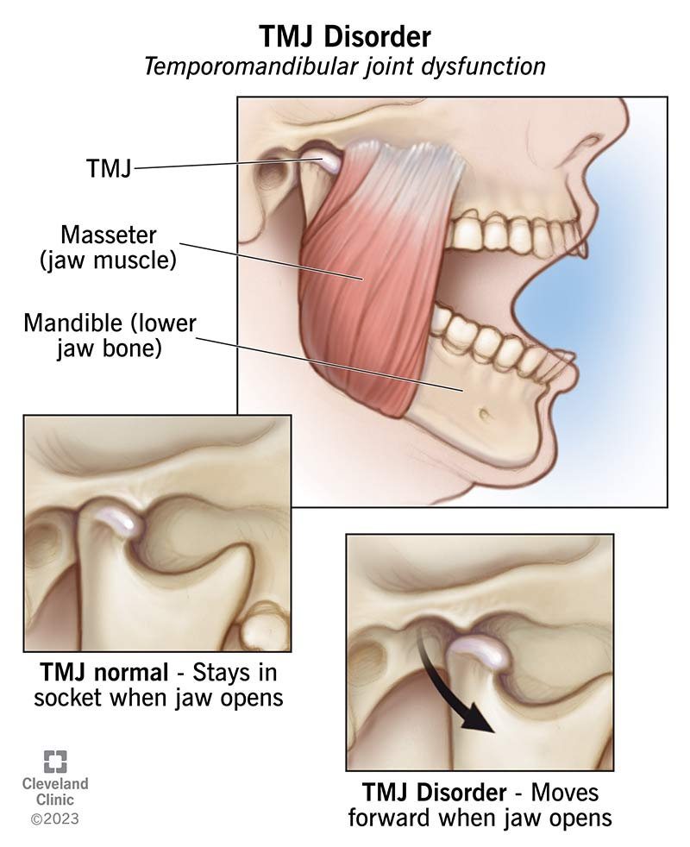
TMJ dysfunctions are conditions affecting your jaw joints and surrounding muscles and ligaments. These conditions can cause several issues, including jaw pain, headaches and difficulty opening and closing your mouth.
You might hear people call these conditions TMJ. But “TMJ” refers to your actual jaw joint, while “TMD” stands for temporomandibular joint dysfunction. Another name is temporomandibular joint disorder.

Slide 20
Types of TMD (temporomandibular joint dysfunction)
Disorders of your jaw joints, 2. Disorders of your chewing muscles.
3. Headaches that result from TMD.
symptoms of TMJ dysfunction;
Jaw pain, Facial pain, Shoulder or neck pain, Stiffness in your jaw, Difficulty opening or closing your mouth, Jaw popping or clicking, Headaches, Migraines.
Earaches, Toothache, Tinnitus (ringing in your ears).
A change in the way your teeth fit together (malocclusion).
stress

Slide 21
Things that make TMJ dysfunction worse
You can’t always control factors that cause TMJ dysfunction. But certain habits can make TMD worse, including:
Using your teeth as tools (like tearing off clothing tags).
Poor posture. (This can place excess pressure on your neck, shoulder and facial muscles.)
Chewing on pens, pencils or other items (a common “nervous habit” behavior).
Chewing on ice or excessively chewing gum.
Taking big bites of food. (This can overwork your jaw muscles.)
Daytime teeth clenching or grinding.
Sleeping on your stomach.

